Slide 1
NEWLANDS CLINIC
RESEARCH MASTERCLASS FOR CLINICIANS · MODULE 1
The Epidemiological Focus
Defining Cases and Populations
www.newlandsclinic.org.zw

Slide 2
MODULE 1 · TOPIC 2 · FOUNDATIONS IN EPIDEMIOLOGY
The Epidemiological Focus
Before any rate or comparison is possible, two questions must be answered: who counts as a case, and from what population did those cases arise? This session builds that foundation.
BY THE END OF THIS SESSION, YOU WILL BE ABLE TO:
1
1
Explain how epidemiologists define a “case” and why this matters.
WHY IT MATTERS
2
Distinguish the epidemiological meaning of “population” from the demographic one.
A poorly defined case or population invalidates every statistic built from it — no statistical fix can repair this later.
3
Define an appropriate population at risk for a given case definition.
Describe a health event using person, place and time.
4
5
Distinguish exposures from outcomes in a research question.
Research Masterclass for Clinicians
www.newlandsclinic.org.zw
Notes:
Who counts is the foundational question in epidemiology
Epidemiology was in very early stages the sciences of counting who had disease, this has obviously evolved

Slide 3
SECTION 1 · FOUNDATIONS
Why “Who Counts?” Is the First Question
Before any number can be calculated, two things must be pinned down: what counts as a case, and which population those cases were drawn from.
Traditionally, epidemiological research focused on disease occurrence/counting
Today it studies a much wider range of health-related states — but every measurement still starts with the same two decisions: define the case, then define the population.
Research Masterclass for Clinicians
www.newlandsclinic.org.zw

Slide 4
SECTION 1 · FOUNDATIONS
KNOWLEDGE CHECK
Research Masterclass for Clinicians
www.newlandsclinic.org.zw
Notes:
Question will display on my screen, there is to answer on their screens

Slide 5
SECTION 2 · THE FOUNDING CASE
John Snow and the Broad Street Pump, 1854
1853
SEP 1854
7 SEP
AFTER
Recurring epidemics; miasma theory dominant
>500 deaths in 10 days near Broad Street
Snow has the pump handle removed
New cases subside; confirmed by Whitehead
HOW SNOW DEFINED A CASE
HOW SNOW DEFINED THE POPULATION
No laboratory test existed — Koch identified Vibrio cholerae decades later. Snow used a clinical and circumstantial case definition: a death attributed to cholera, plotted by exact address, during August–September 1854.
Not “the population of London” — but everyone who drew water from a given pump or water company. Roughly 700 deaths within a 230m radius were compared by household water source.
Research Masterclass for Clinicians
www.newlandsclinic.org.zw
Notes:
John Snow. Regarded as on of the founding fathers of epidemiology
Miasma theory. Diseases were caused by “bad air”
The lesson: a case definition doesn't require a lab test — it requires consistent, applicable criteria, paired with a clearly defined population

Slide 6
SECTION 2 · THE FOUNDING CASE
The Grand Experiment — and Its Modern Echo
THE “GRAND EXPERIMENT”, LONDON, 1854
Snow identified two water companies supplying overlapping streets in South London — a natural experiment. Over seven weeks, mortality among households supplied by the sewage-contaminated Southwark & Vauxhall Company was roughly fourteen times higher than among those supplied by the Lambeth Company.
170 YEARS LATER — HARARE, 2008–09
Zimbabwe recorded 98,592 cholera cases and 4,288 deaths over eleven months. Luque-Fernández et al. (2011, Trans R Soc Trop Med Hyg) applied Snow's exact logic at suburb level — calculating each Harare suburb's own attack rate (1.2 per 1,000 in Tynwald to 90.3 per 1,000 in Hopley) and comparing them geographically to identify high-risk areas.
Why this matters: both investigations could only compare populations because cases and the population at risk had been defined consistently enough to count.
Research Masterclass for Clinicians
www.newlandsclinic.org.zw
Notes:
Water from different sources (exposures) and the outcome(mortality)
The example here from join snow shows a natural experiment, a form of a quasi experiment. The research no true random assignment to exposure groups(circumstances assigned). Natural random assignment

Slide 7
SECTION 2 · THE FOUNDING CASE (CONT.)
The epidemiological triad — why disease occurs
Snow could stop the 1854 outbreak because cholera — like all disease — results from three interacting factors, classically drawn as a triangle.
AGENT
disease occurs only where
all three sides meet
HOST
ENVIRONMENT
Agent
Host
Environment
The organism, chemical, or physical factor that must be present for disease to occur.
The person or population's susceptibility — immunity, nutrition, age, prior exposure.
External conditions that bring agent and host together — water, sanitation, crowding.
Vibrio cholerae, the bacterium responsible for cholera.
Malnourished, immune-naïve populations suffer more severe outcomes.
The contaminated Broad Street pump; inadequate WASH in Harare's suburbs.
Why it matters: you don't need to eliminate the agent if you can remove the environmental pathway or protect the host instead.
Research Masterclass for Clinicians
www.newlandsclinic.org.zw
Notes:
3 necessary conditions for a disease to occur

Slide 8
SECTION 2 · THE FOUNDING CASE (CONT.)
Breaking the triangle — from Broad Street to Harare
Every cholera control strategy, historical or modern, works by breaking one side of the triad.
Triad component | Intervention example | Effect
Agent | Chlorination, oral rehydration and antibiotics | Reduces or kills the pathogen
Host | Oral cholera vaccine, nutrition support | Builds host immunity and resilience
Environment | Removing the Broad Street pump handle (1854); WASH infrastructure investment (Zimbabwe, 2008–2024) | Cuts the transmission pathway
Snow's intervention — removing the pump handle — broke only the environmental side of the triangle. He didn't need to identify the agent (Vibrio cholerae, discovered decades later by Koch) or treat any host to stop the outbreak.
Research Masterclass for Clinicians
www.newlandsclinic.org.zw
Notes:
This applies to most infectious diseases, eg malaria

Slide 9
SECTION 3 · FOUNDATIONS
Two Things to Define Before You Count Anything
1
What we mean by a case
2
The population the cases came from
A standardised rule that lets anyone, anywhere, decide whether a person or event would be counted as a case.
The group of people who could potentially have become — or could become — cases under that same definition.
Determines The numerator
Determines The denominator
Numerator and denominator must be built from the same logic — a proportion estimate from a careful numerator divided by a careless denominator is not meaningful
Research Masterclass for Clinicians
www.newlandsclinic.org.zw
Notes:
Case definition is about considensency

Slide 10
SECTION 4 · DEFINING A CASE
The Case Definition
A standardised set of criteria used to identify cases. Not necessarily the same as the everyday clinical definition.
NEWLANDS CLINIC — HYPERTENSION
ZIMBABWE — CHOLERA, 2023–24
Documented systolic BP >140 mmHg and/or diastolic BP >90 mmHg on at least two different days, or current use of antihypertensive medication.
Suspected case: acute watery diarrhoea (clinical). Confirmed case: laboratory isolation of Vibrio cholerae, or positive RDT.
A rule that can be applied consistently to every patient record, regardless of who reviews the chart.
34,549 suspected cases, 718 deaths (CFR 2.1%) — a much smaller subset was laboratory-confirmed (Olatunji et al., 2024).
Why it matters: too broad over-counts; too narrow under-counts; inconsistent definitions prevent comparison across studies or sites.
Research Masterclass for Clinicians
www.newlandsclinic.org.zw

Slide 11
SECTION 4 · DEFINING A CASE
Three Things a Good Case Definition Should State
METHOD OF IDENTIFICATION
BOUNDARIES OF A CASE
UNIT OF ANALYSIS
How will a case be detected — clinical symptoms, a lab test, self-report, or a combination?
Severity thresholds, time windows, and explicit exclusions all set the boundary of what counts.
Is the case a person, an episode, a household, a suburb, or an event?
Snow's method was clinical and circumstantial; Zimbabwe's confirmed-case definition is laboratory-based.
E.g. excluding women already hypertensive before 20 weeks' gestation in a pre-eclampsia study.
Luque-Fernández's cholera analysis used the suburb, not the individual, as its unit.
Research Masterclass for Clinicians
www.newlandsclinic.org.zw
Notes:
The person, place and time principle applies here

Slide 12
SECTION 5 · DEFINING THE POPULATION
“Population” Means Something Different Here
Epidemiologists constantly ask: what is the denominator? — the population from which the cases arose.
EPI
Epidemiology
DE
Demography
Population = the collection of units from which a sample or set of cases is drawn — people, clinics, households, or events. Defined by the research question.
Population = the inhabitants of a country, district, or area — a fixed geographic and administrative concept.
Newlands Clinic example: the IeDEA–Newlands cohort enrolled all patients aged ≥16 starting ART at the clinic, 2004–2015 — not “all Zimbabweans”. The denominator is defined by enrolment criteria, not a map.
Research Masterclass for Clinicians
www.newlandsclinic.org.zw
Notes:
Population is people at risk of having the defined outcome of interest.

Slide 13
SECTION 5 · DEFINING THE POPULATION
The Population at Risk
The study population is often called the population at risk: everyone who could potentially become a case under the case definition in use.
POST-PARTUM HAEMORRHAGE
CERVICAL CANCER
Case: ≥500 mL blood loss in 24 hours after birth. Population at risk: all women who gave birth at the hospital during the study period — each woman at risk only for her own first 24 hours.
Women with a hysterectomy are not at risk, but routine statistics often cannot exclude them — so the total resident population is used as a practical, if imperfect, proxy.
Research Masterclass for Clinicians
www.newlandsclinic.org.zw

Slide 14
SECTION 6 · DESCRIBING A HEALTH EVENT
Person, Place and Time
Every health event can be characterised in three dimensions — the structure of Snow's 1854 map itself.
PERSON — WHO?
PLACE — WHERE?
TIME — WHEN?
Age, sex, occupation, HIV status, ART regimen, BMI — or, for Snow, which households used which pump.
Country, district, clinic catchment, urban vs rural — or, for Snow, the street address relative to Broad Street.
Calendar period, secular trend, season — or, for Snow, before/after the pump handle was removed.
Worked example (Newlands Clinic): “Prevalence of hypertension among HIV-positive adults aged ≥50 (65% women) at Newlands Clinic, Harare was 41.2% as of 1 October 2019.”
Research Masterclass for Clinicians
www.newlandsclinic.org.zw
Notes:
Get volunteers to identify the different parts of the PPT

Slide 15
SECTION 7 · THE FOCUS IN PRACTICE
Exposures and Outcomes
EXP
Exposure
OUT
Outcome
Any factor that may influence the outcome — biological, behavioural, environmental, or structural. For Snow: which water company supplied a household.
The disease, event, or health-related state — defined by the case definition. Need not be a disease.
Study | Exposure | Outcome (case definition)
Snow's Grand Experiment (1854) | Water company | Death attributed to cholera
Cholera spatial analysis, Harare (2011) | Suburb of residence | Cholera case, per surveillance definition
Dolutegravir & hypertension, Newlands | ART regimen (DTG vs EFV) | Hypertension (BP >140/90, or treatment)
Research Masterclass for Clinicians
www.newlandsclinic.org.zw

Slide 16
SECTION 8 · READING CRITICALLY
Pitfalls When Cases and Populations Are Defined Poorly
South Africa, 2007: HIV prevalence in TB patients reported as 74% — but only 39% of TB patients were ever HIV tested.
NUMERATOR/DENOMINATOR MISMATCH
 | What it should be | What it actually was
Case (numerator) | TB patients testing HIV-positive | HIV-positive results, but only among the 39% tested
Population at risk (denominator) | All TB patients notified that year | Silently reported as if it were "all patients," but really just the tested subgroup
Research Masterclass for Clinicians
www.newlandsclinic.org.zw
Notes:
Mismatch of numerator and denominator. Can lead to underestimation/overestimation of risk/prevalence of disease/event
q. What do you think happened here. How was the prevalence of HIV in this population STATED?
Take home. The numerator and denominator must be built from the same logic/population

Slide 17
SECTION 8 · READING CRITICALLY
Pitfalls When Cases and Populations Are Defined Poorly
DEFINITION DRIFT
A surveillance case definition tightened or loosened mid-outbreak can make case counts move for reasons unrelated to transmission.
Level | Criteria
Official Ministry of Health definition | Sudden high fever followed by a vesiculopustular rash on the face/palms/soles, OR ≥5 smallpox-type scars, OR fever >38.3°C, severe headache, lymphadenopathy, back pain, myalgia, severe asthenia, followed by a progressive rash
Community-level definition | Any person with fever and a skin rash counted as suspected
Facility-level definition (e.g., Uvira Treatment Centre, post-outbreak confirmation) | Anyone presenting with a skin rash or papulovesicular/pustular eruption — no fever requirement
Research Masterclass for Clinicians
www.newlandsclinic.org.zw
Notes:
In outbreak investigations, this is usually the case and there is need to always have the context set in writing and interpreting (usually the methods section) of most publications
Transparency is what matters

Slide 18
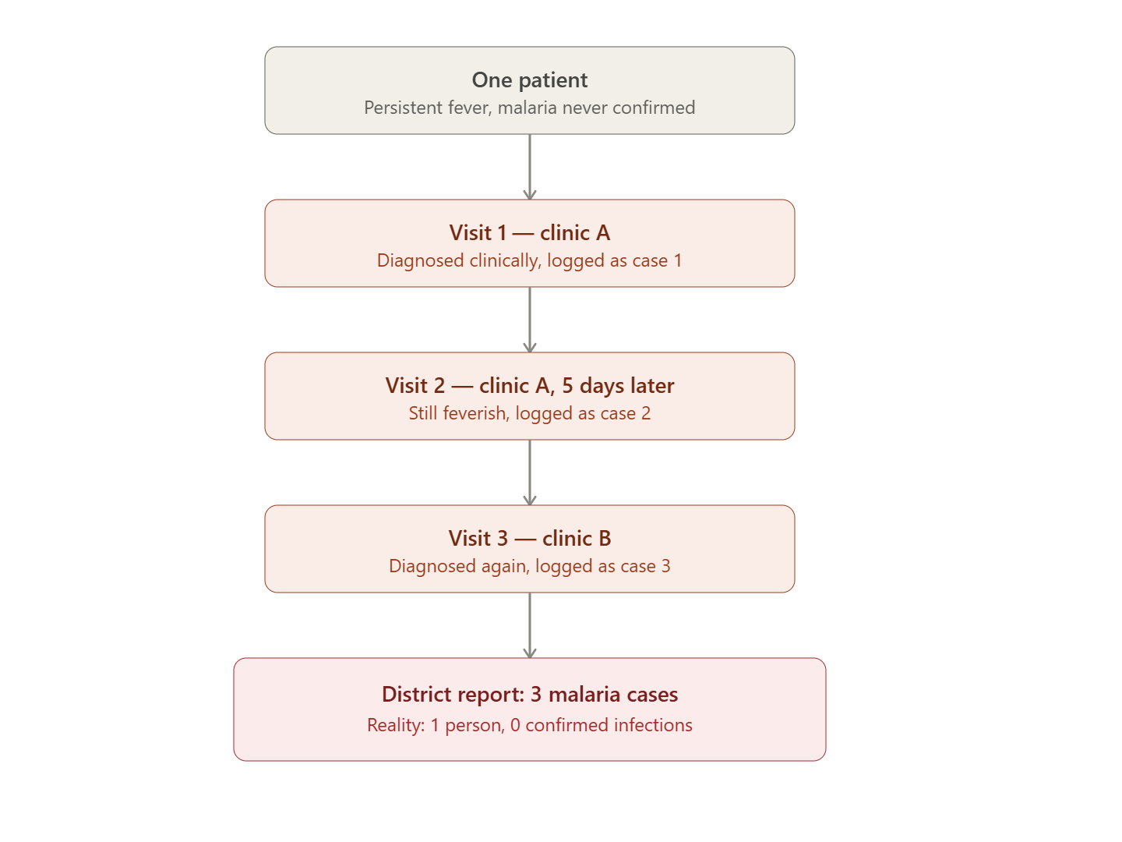
SECTION 8 · READING CRITICALLY
Pitfalls When Cases and Populations Are Defined Poorly
CONFLATING UNITS: Reporting “cases” without specifying people vs episodes, for any condition that can recur in the same person
.
Research Masterclass for Clinicians
www.newlandsclinic.org.zw
Notes:
Often leads to mixing of people and episodes leading to overstating of cases.

Slide 19
SECTION 8 · READING CRITICALLY
Pitfalls When Cases and Populations Are Defined Poorly
IMPLICIT POPULATION
Quoting a rate without ever stating the denominator population leaves the reader unable to judge whether the figure is meaningful.
1 in 3", "1 in 5", or 53%: South Africa's gender-based violence statistics
Research Masterclass for Clinicians
www.newlandsclinic.org.zw
Notes:
Always ask what is the denominator/ source population
Politicians are infamous for this

Slide 20
Key Takeaways
✓
A case definition is a standardised rule for deciding who counts — it determines the numerator.
✓
The study population (population at risk) is everyone who could potentially become a case — it determines the denominator.
✓
In epidemiology, “population” means the units a sample is drawn from, not a fixed geographic area as in demography.
✓
Every health event can be described using person, place and time.
✓
Every study measures an exposure and an outcome; the case definition applies to the outcome.
✓
John Snow's 1854 investigation combined all of these ideas without a single laboratory test — and the same logic still drives Zimbabwe's cholera surveillance today.
Research Masterclass for Clinicians
www.newlandsclinic.org.zw

Slide 21
REFERENCES
Sources Used in This Session
1.
Snow J. On the Mode of Communication of Cholera. 2nd ed. London: John Churchill; 1855.
2.
Brody H, Rip MR, Vinten-Johansen P, Paneth N, Rachman S. Map-making and myth-making in Broad Street: the London cholera epidemic, 1854. Lancet. 2000;356(9223):64–68.
3.
Luque-Fernández MA, Mason PR, Gray H, et al. Descriptive spatial analysis of the cholera epidemic 2008–2009 in Harare, Zimbabwe. Trans R Soc Trop Med Hyg. 2011;105(1):38–45.
4.
Mashe T, Chaibva BV, Nair P, et al. Descriptive epidemiology of the cholera outbreak in Zimbabwe 2018–2019. BMJ Open. 2023;13(1):e059134.
5.
Olatunji G, Kokori E, Moradeyo A, et al. A perspective on the 2023 cholera outbreaks in Zimbabwe. J Epidemiol Glob Health. 2024;14(1):243–248.
6.
Shamu T, Chimbetete C, Shawarira-Bote S, Mudzviti T, Luthy R. Outcomes of an HIV cohort after a decade of comprehensive care at Newlands Clinic, Harare, Zimbabwe: TENART cohort. PLoS One. 2017;12(10):e0186726.
7.
Chimbetete C, et al. Profile of elderly patients receiving antiretroviral therapy at Newlands Clinic in 2020: a cross-sectional study. S Afr J HIV Med. 2020;21(1).
8.
Porta M, ed. A Dictionary of Epidemiology. 6th ed. Oxford: Oxford University Press; 2014.
Research Masterclass for Clinicians
www.newlandsclinic.org.zw

